Slide 1
Screens how create VM, Service account, SSH, install Docker, Terraform

Slide 2
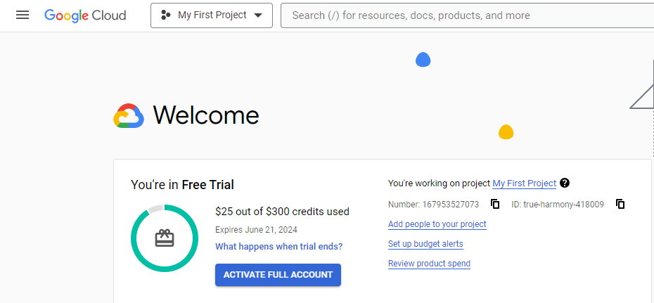

Slide 3
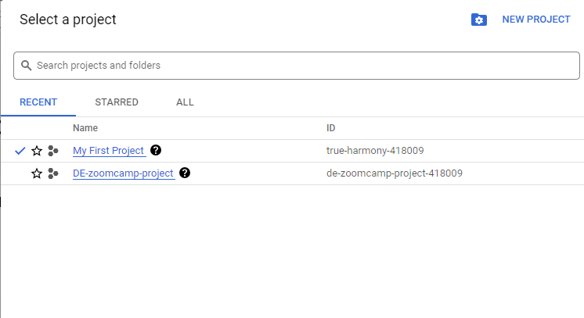

Slide 4
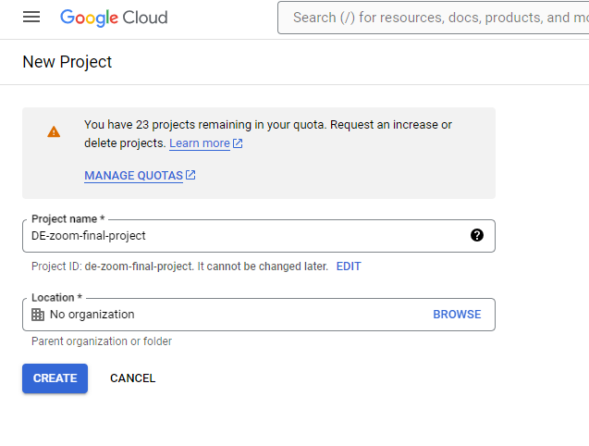

Slide 5
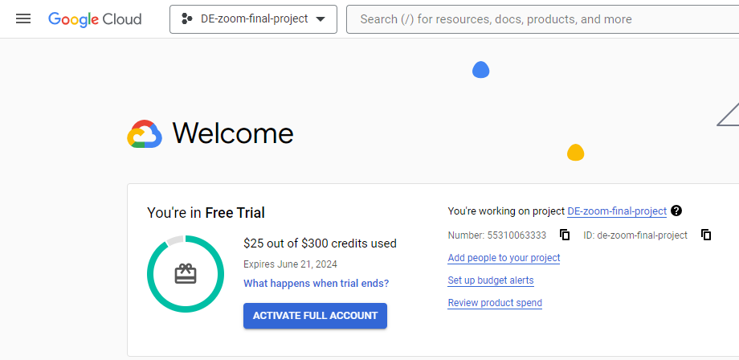

Slide 6
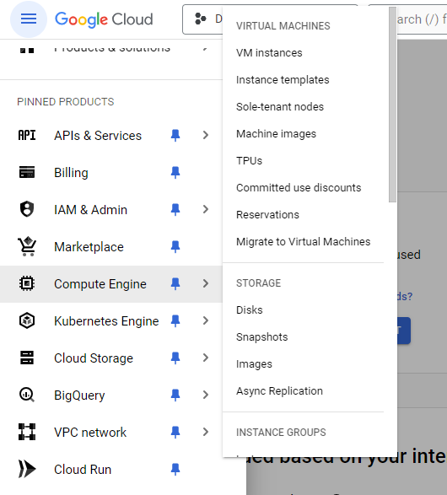

Slide 7
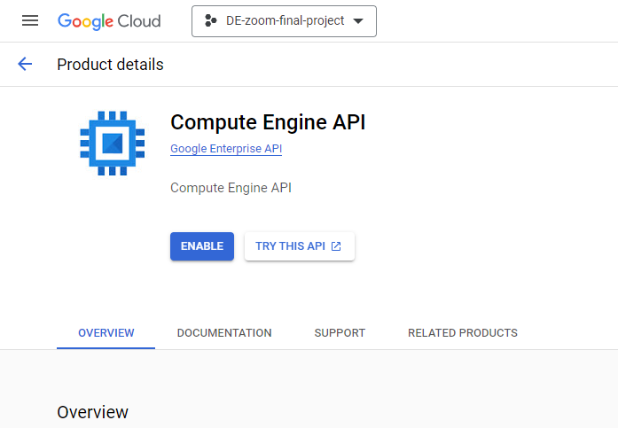

Slide 8
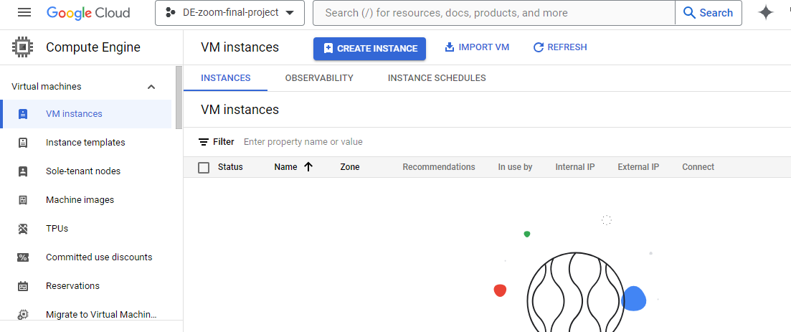

Slide 9
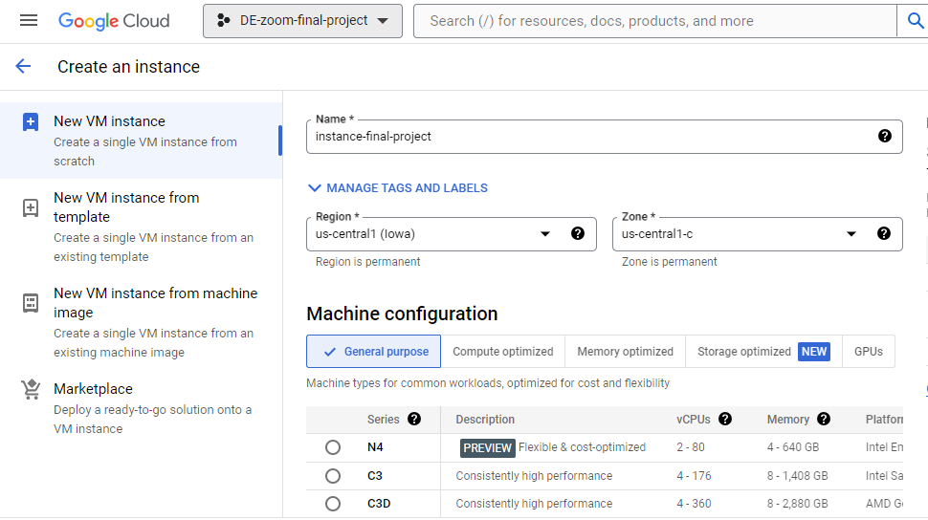

Slide 10
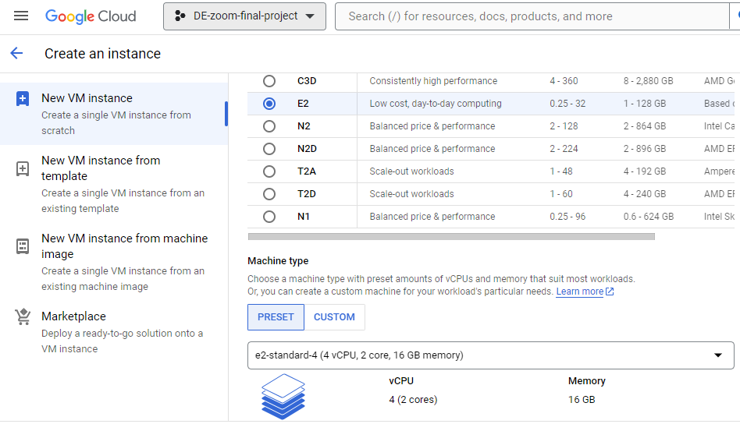

Slide 11
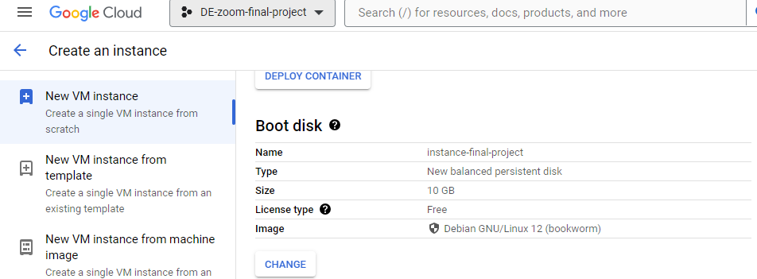

Slide 12
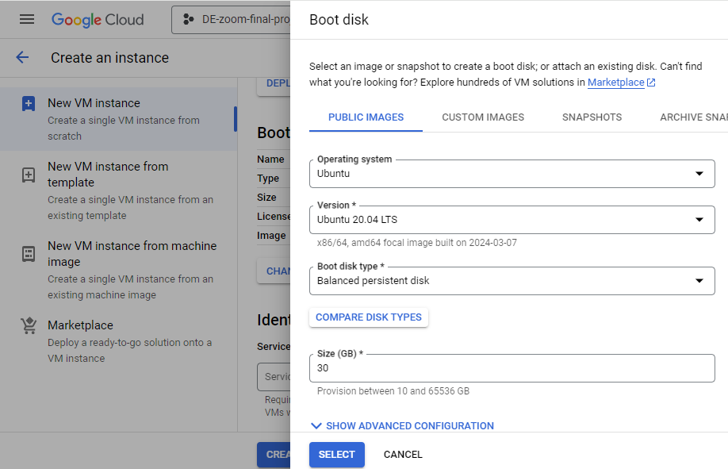

Slide 13
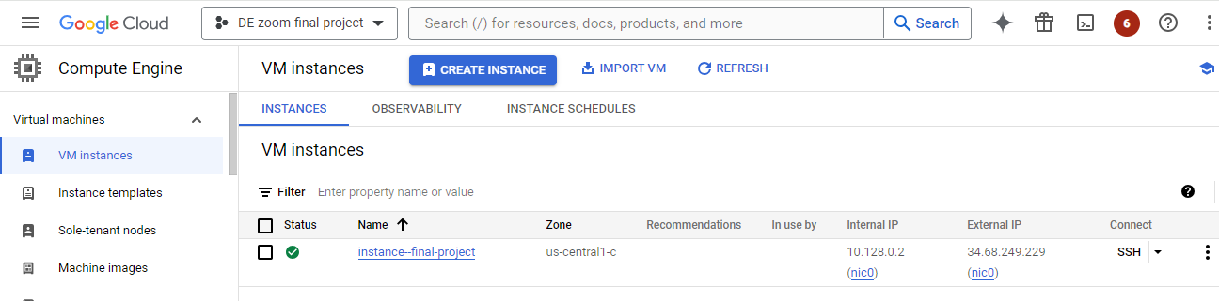

Slide 14
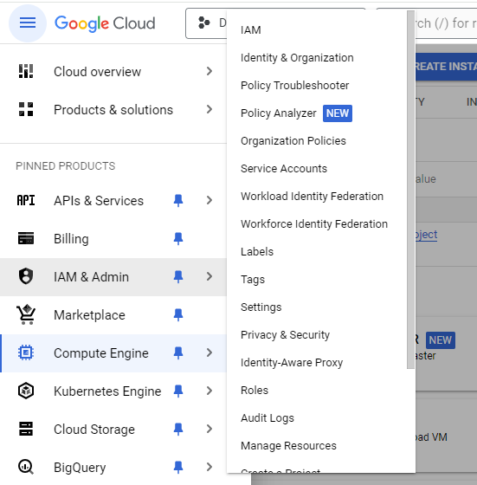

Slide 15
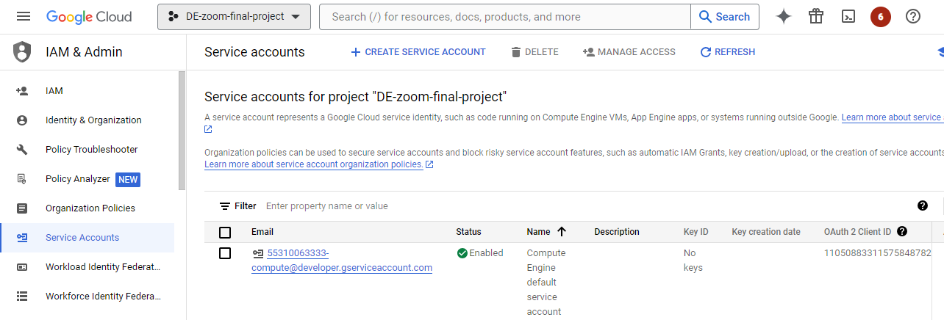

Slide 16
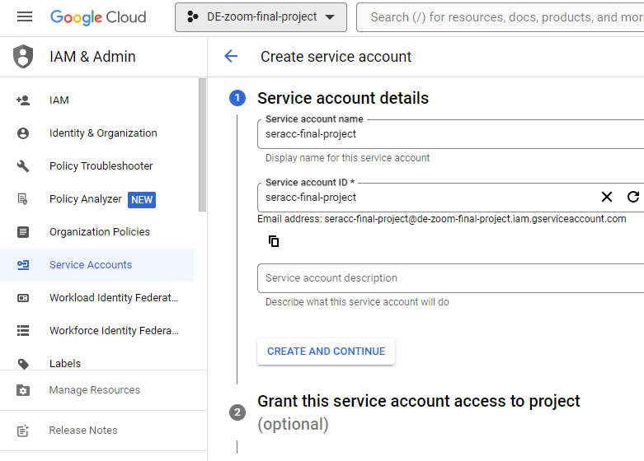

Slide 17
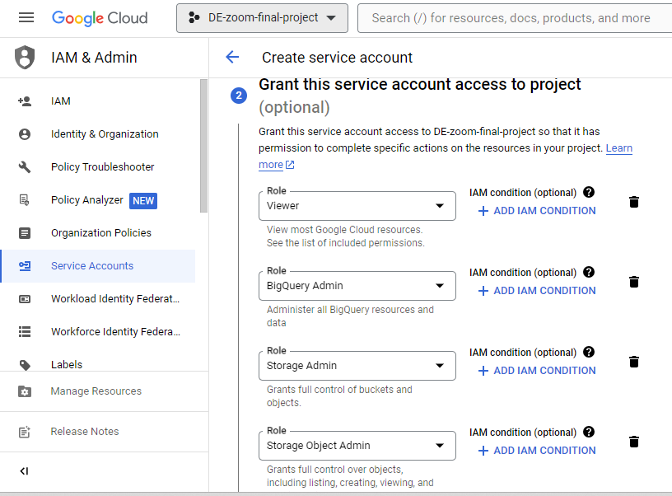

Slide 18
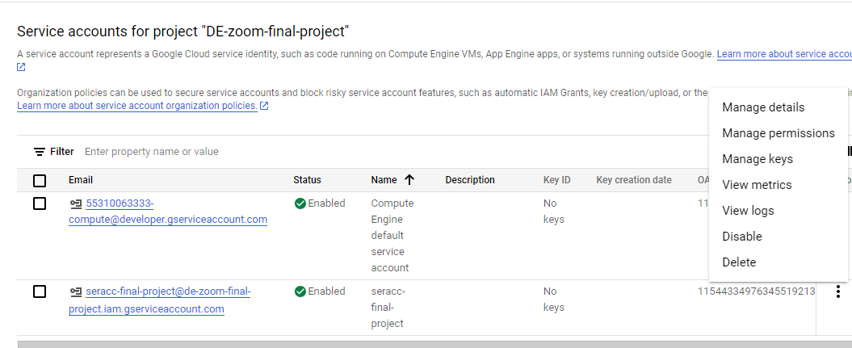

Slide 19
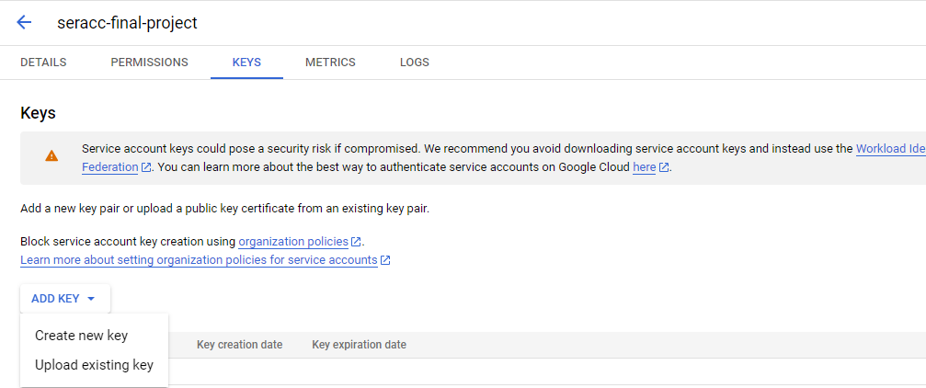

Slide 20
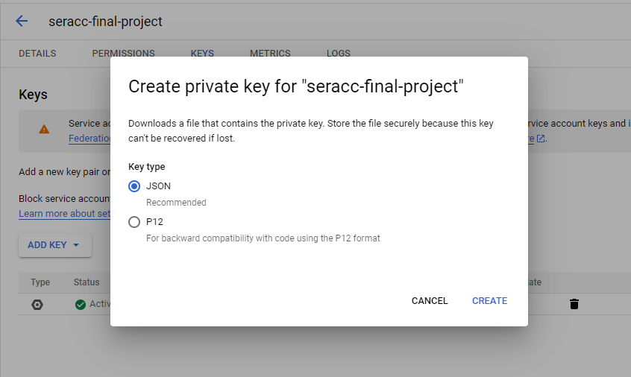

Slide 21
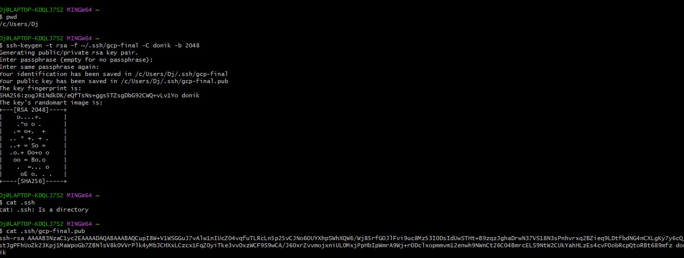

Slide 22
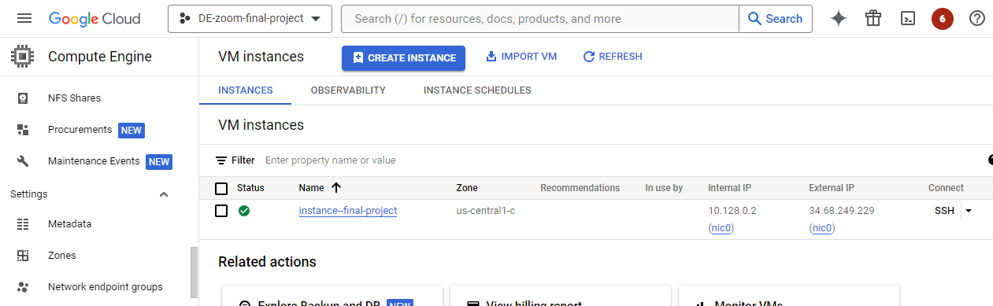

Slide 23
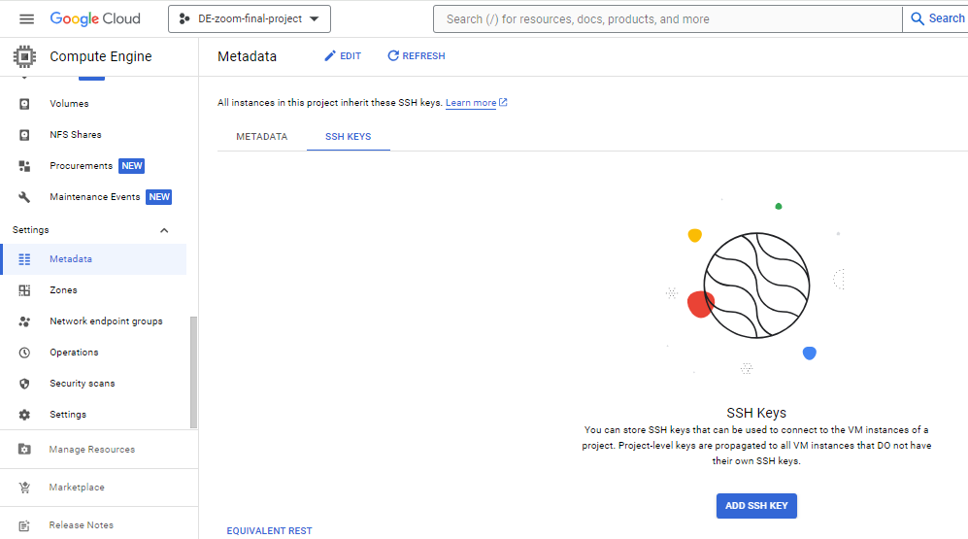

Slide 24
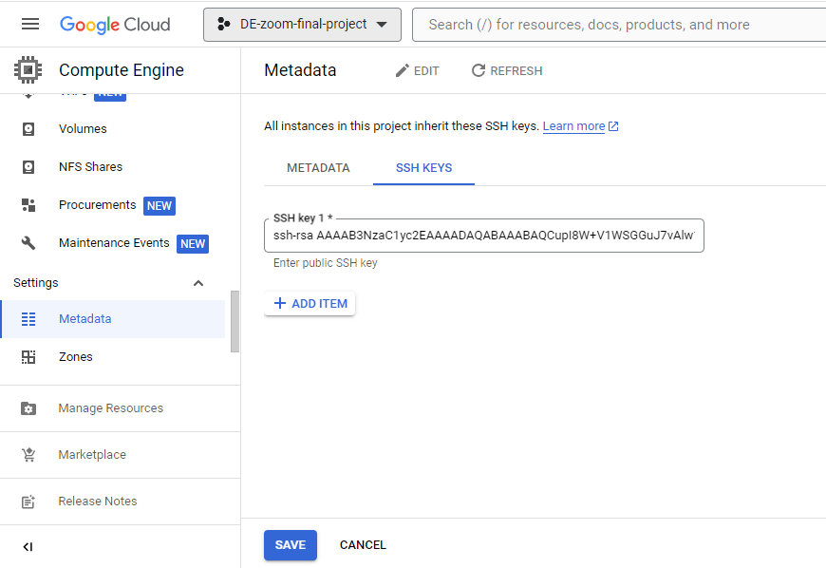

Slide 25
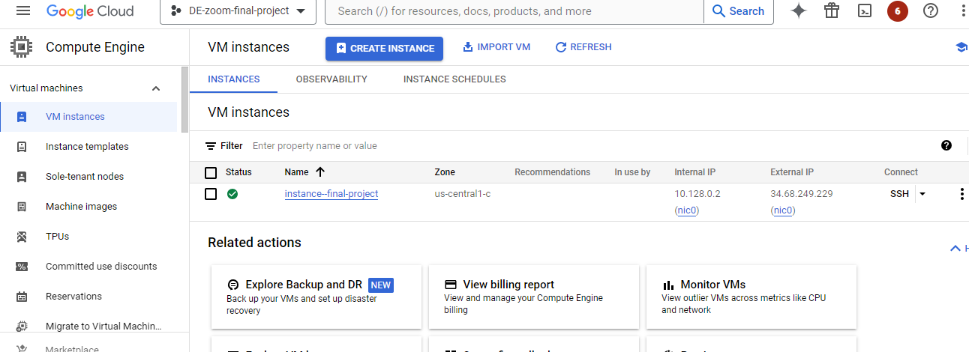

Slide 26

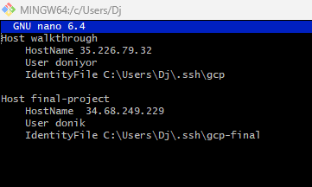

Slide 27
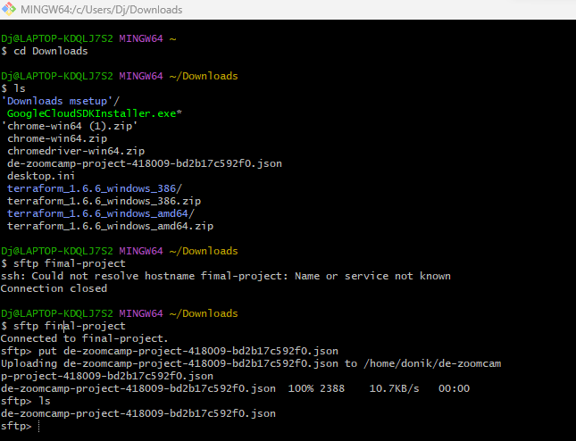
ssh final-project

Slide 28
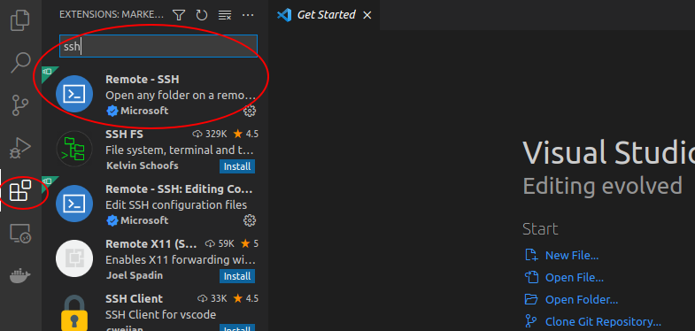

Slide 29
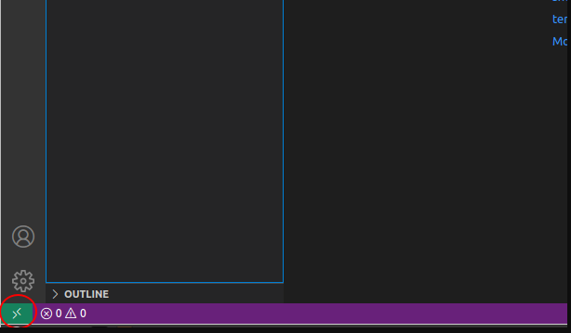

Slide 30
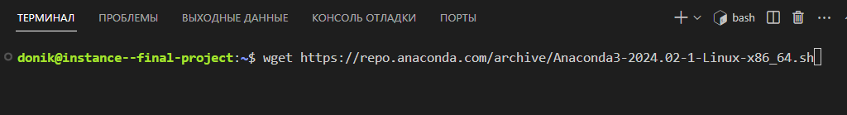
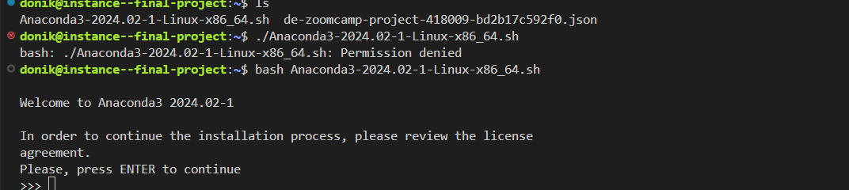

Slide 31
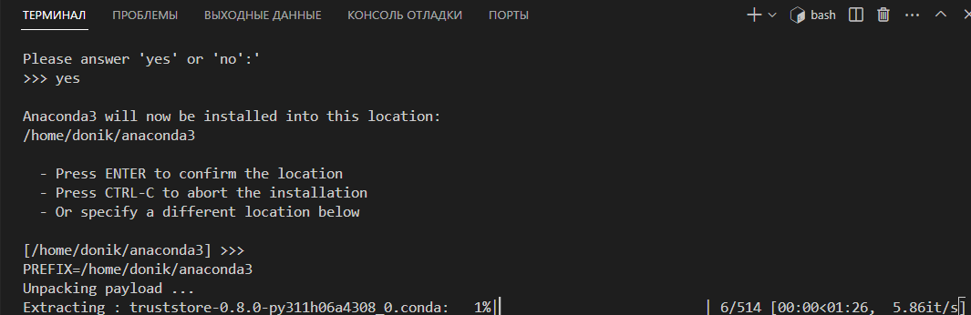

Slide 32
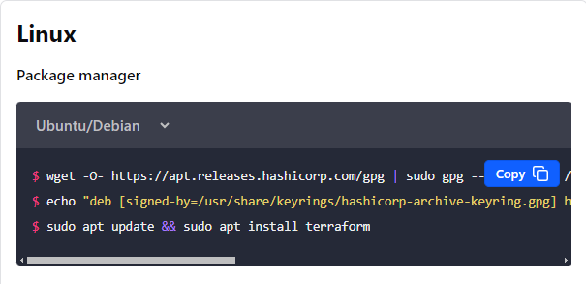

Slide 33
mkdir -p .google/credentials
cp <your service account json file> .google/credentials/google_credentials.json
nano .bashrc
export GOOGLE_APPLICATION_CREDENTIALS=/google/credentials/google_credentials.json
source .bashrc
gcloud auth activate-service-account --key-file $GOOGLE_APPLICATION_CREDENTIALS

Slide 34
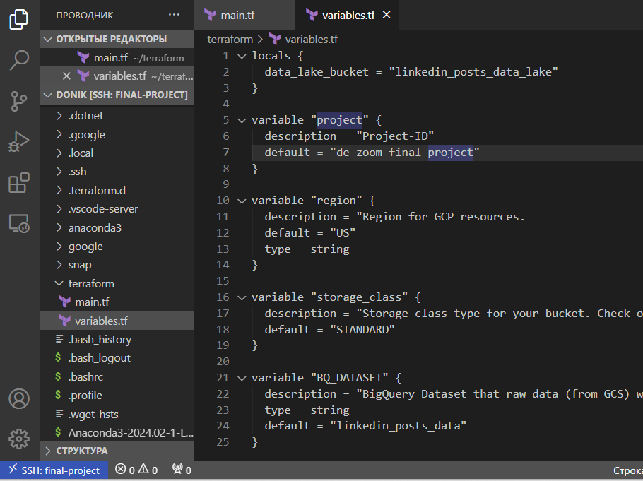

Slide 35
Run the commands
When it prompts you just type "yes”
cd terraform
terraform init
terraform apply

Slide 36
first update with sudo apt-get update
Install docker with sudo apt install docker.io
Clone this repo git clone https://github.com/MichaelShoemaker/shoemaker-de-zoomcamp-final-project.git
Make a bin directory with and switch to it
mkdir bin cd bin
Download docker-compose wget https://github.com/docker/compose/releases/download/v2.3.4/docker-compose-linux-x86_64 -O docker-compose
Make it execuatable chmod +x docker-compose

Slide 37
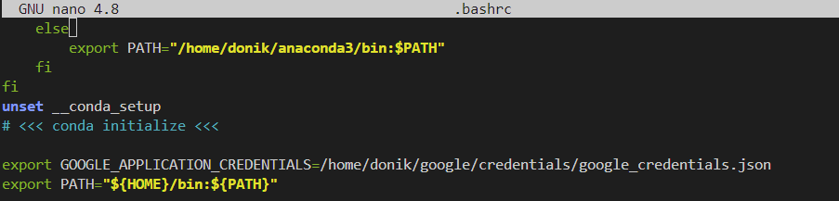
Add docker-compose to path in your .bashrc file
Update your path by running source .bashrc

Slide 38
you can start by cloning the repo:
git clone https://github.com/mage-ai/mage-zoomcamp.git mage
Navigate to the repo:
cd mage
Rename dev.env to simply .env— this will ensure the file is not committed to Git by accident, since it will contain credentials in the future.
(base) donik@instance--final-project:~$ sudo usermod -aG docker $USER
(base) donik@instance--final-project:~$ newgrp docker
docker compose build
(base) donik@instance--final-project:~/mage$ docker pull mageai/mageai:latest
Now, let's build the container
Finally, start the Docker container:
(base) donik@instance--final-project:~/mage$ docker-compose up
doker compose up
Now, navigate to http://localhost:6789 in your browser!

Slide 39
